Slide 1
Bulkpro analysis
Case study

Slide 2
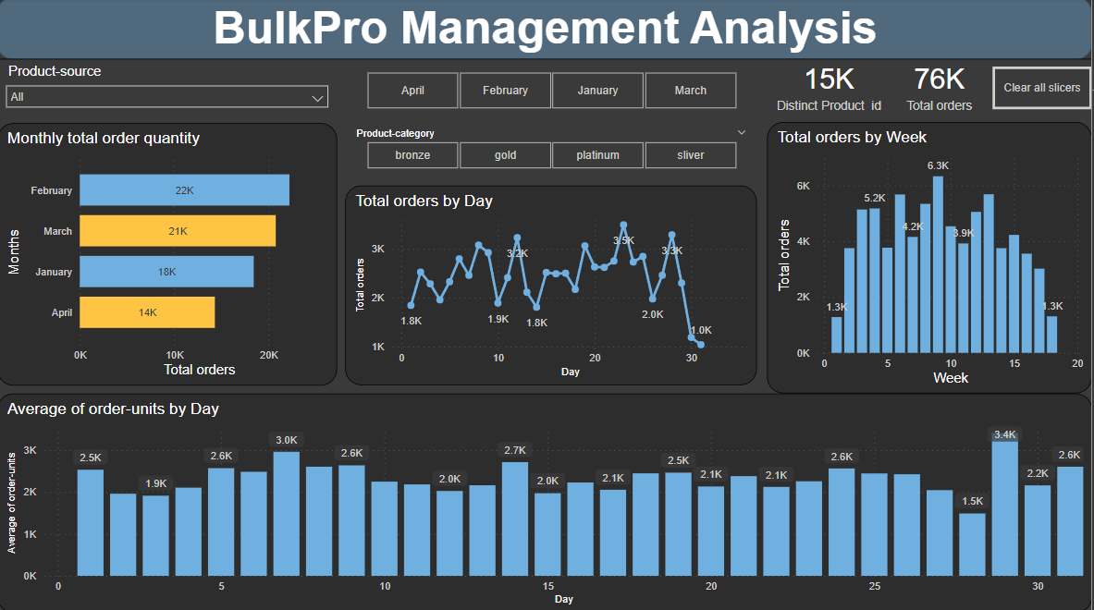

Slide 3
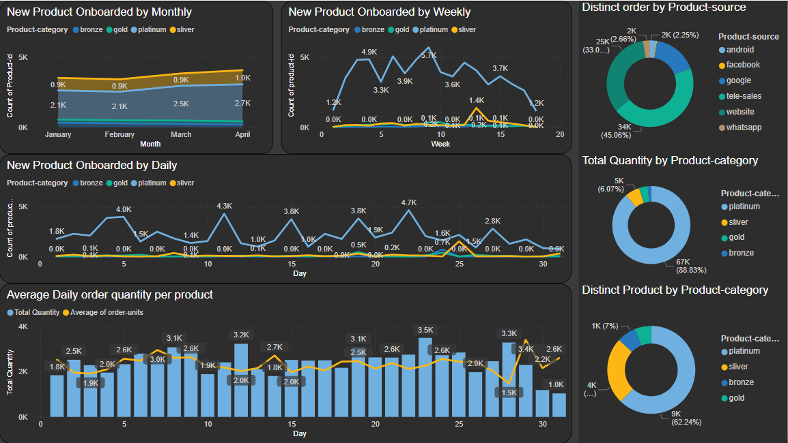

Slide 4
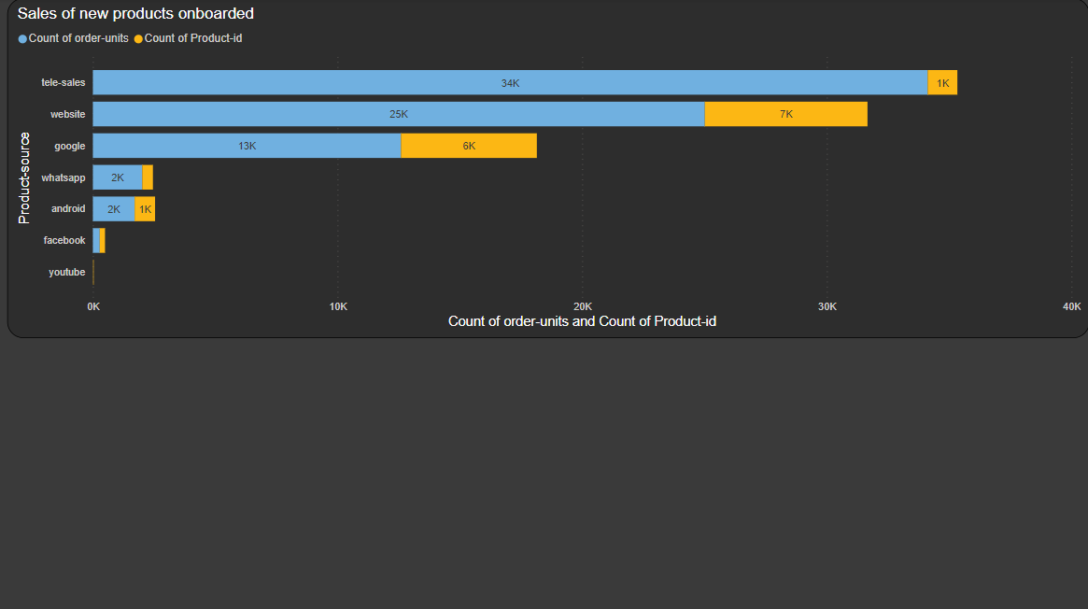

Slide 5
Introduction
Purpose of case study to analysis the important numbers like how much we sell each month and each day, as well as how many products we sell on average each day. We'll also check out the new products we've added and how well they're selling. Plus, we'll see which channels and parts of our business are doing the best.
with the key metrics of –
Monthly total order quantity
Daily total order quantity
Average Daily order quantity per product
New products onboarded (Monthly / Weekly / Daily)
Sales of new products onboarded (not every product that is listed on the website would actually be purchased)

Slide 6
PRIMARY GOALS
Finding Key Insights

Slide 7
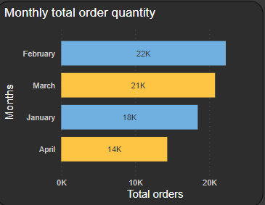
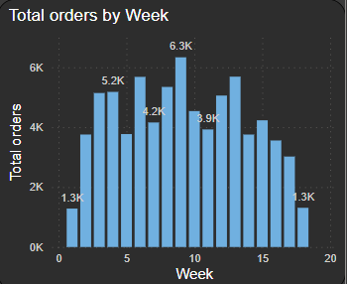
1. Monthly and weekly total order quantity

Slide 8
In February, Bulkpro experienced a significant increase in order quantity, with approximately 22,000 units ordered, surpassing all other months. Additionally, analysis by week number revealed that the 6th, 8th, and 9th weeks saw notably higher quantities ordered compared to other weeks.

Slide 9
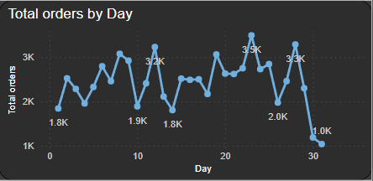
2. Daily total order quantity with their average

Slide 10
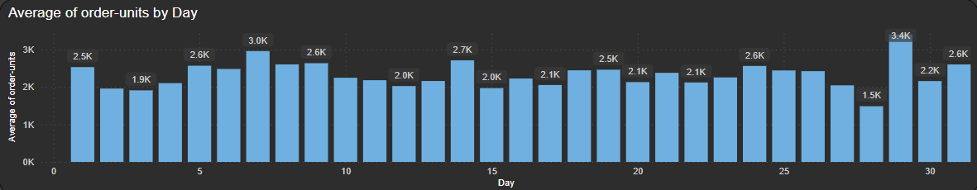
In the daily trend, we noticed a pattern where the quantity of orders alternated between increasing and decreasing day by day. The peak day for orders was the 28th day of the month, with around 3.5k units ordered, surpassing other days significantly. Interestingly, although the average order quantity remained balanced, the 29th day saw the highest number of orders placed, indicating a noteworthy spike in sales for that day.

Slide 11
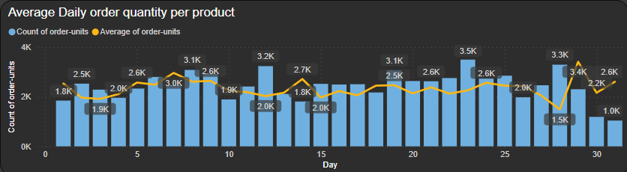
3. Average Daily order quantity per product
The chart displays the average daily order quantity per product. Initially, the total quantity shows a gradual increase. However, towards the end of the month, there's a rapid decrease in quantity. Interestingly, despite this decline, the average order quantity per product increases towards the end of the month.

Slide 12
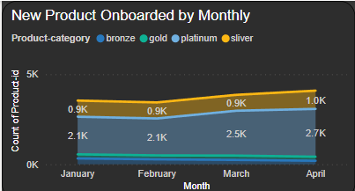
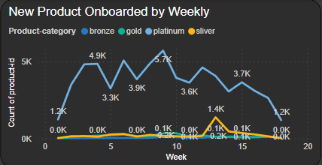
4. New products onboarding (monthly/ monthly/ daily)

Slide 13
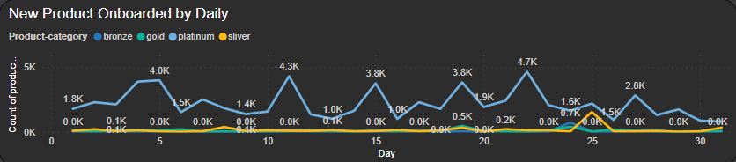
Monthly new products onboarding has been increased from January to April.
Weekly new products onboarding was lower at beginning and end of every month except of 4th week, 6th week and 9th week between January to April months.
Daily new products onboarding has been picked on 5th, 8th and 22nd of all months.

Slide 14
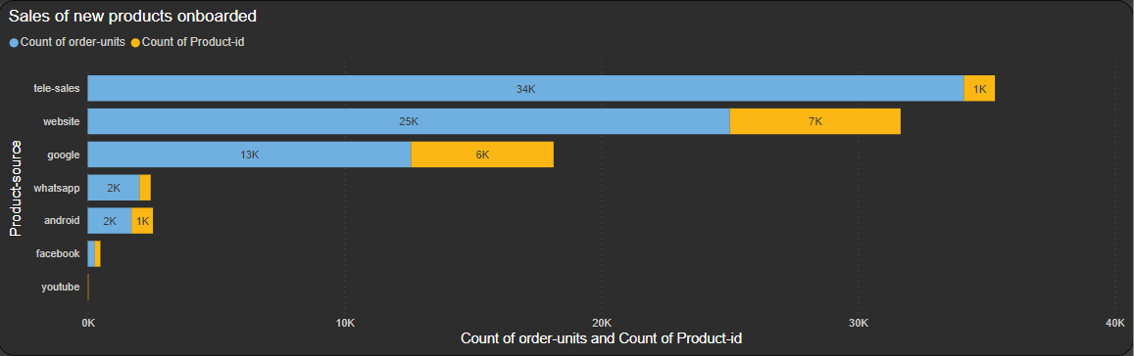
5. Sales of new products onboarded
This bar chart illustrates that sales of new products via tele-sales significantly surpass those from other sources, despite having fewer product listings compared to the website and Google. Interestingly, the number of product listings on tele-sales is equal to that of the Android product source. This suggests that tele-sales drive higher product orders and sales compared to other channels. Furthermore, within each product segment, the Platinum category outperforms others in terms of sales.

Slide 15
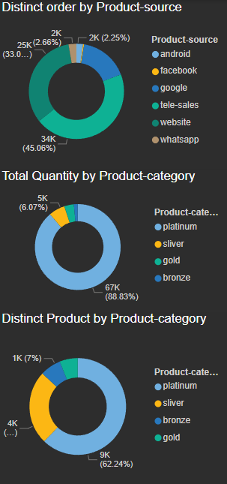

Slide 16
SUMMARY
Bulk pro analysis involves the examination of data in large quantities, typically using automated or semi-automated processes. It aims to identify patterns, trends, and insights within massive datasets efficiently. This analysis can uncover hidden relationships, anomalies, or opportunities that may not be apparent when looking at smaller subsets of data. By leveraging tools like statistical analysis, machine learning algorithms, or data visualization techniques, bulk pro analysis helps organizations make data-driven decisions, optimize processes, and gain a competitive edge in various industries.

Slide 17
THANK YOU
Aman Choudhary
Amanchoudhary11189.ac@gmail.com

